Slide 1

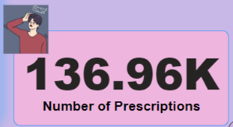
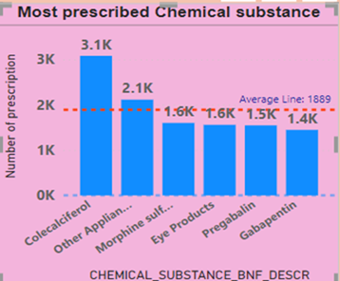
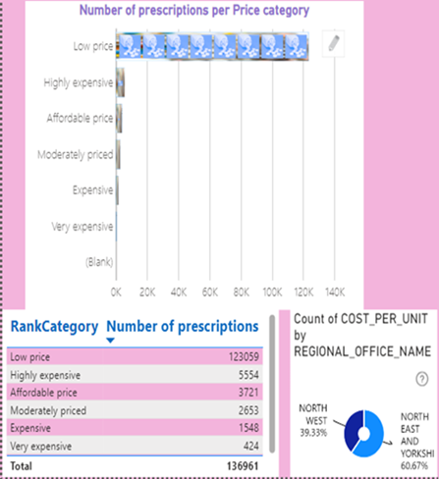
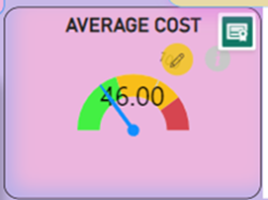
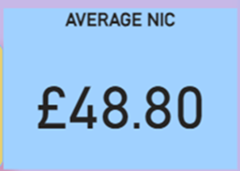
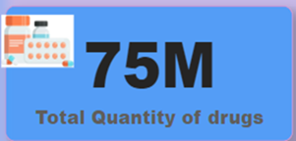
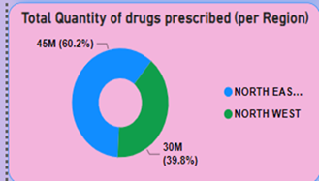
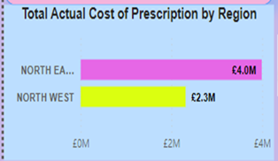
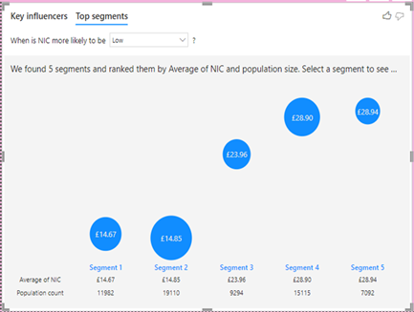
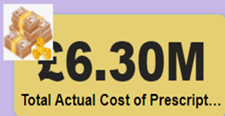
This project is on the analysis of the English Prescribing Dataset (EPD).
In this project, the use of Power BI with advanced features such as DAX (DAta eXpression) and M Language, Artificial Intelligence and various visuals were demonstrated.
Skills developed in the project include: advanced use of Microsoft Power BI, data pre-processing, stakeholder and technical report writing, how to create star schema for data analytics project, use of DAX, M language and Artificial Intelligence.
6 different dashboards were developed by analyzing the dataset for two months (August and September 2023) obtained from the NHS website.
This gives actionable insights and how to improve healthcare service delivery in United Kingdom. Some of the Business questions addressed are:
1. How do Prescribing pattern vary across region in the UK?
2. What are the most prescribed chemical substances?
3.How do prescription pattern change over time? Any improvement in patient outcome?
4.Is there any cost-saving opportunity in prescribing practices?
5. What is the affordability level of drugs prescribed across UK? Is it affordable, highly expensive, etc.?
6. By what margin is the variance between NIC and Actual cost of prescription in UK?
Some of the insights include: Total cost of prescription, quantity of drugs, major organs treated, top chemical substance (BNF code), Actual cost vs Net Ingredient (NIC) margin analysis, etc. across different regions, cities, practice name, ICB.
By Idowu OBISANYA (Student ID: C2861872, M.Sc. Computer Science with Advanced practice

